Slide 1
Logistic regression
Graded task – coronary heart disease

Slide 2
Dataset
4238 patients
15 variables: 6 binary, 9 continuous
1 dependent variable (binary)
Prediction: 10-year risk of coronary heart disease (0: 3505 1: 628 (15%))
Goal: create a logistic regression model for future predictions
sex: binary
age: continuous
currentSmoker: binary
cigsPerDay: continuous
BPMeds: binary
prevalentStroke: binary
prevalentHyp: binary
diabetes: binary
totChol: continuous
sysBP: continuous
diaBP: continuous
BMI: continuous)
heartRate: continuous
glucose: continuous
10 year risk of coronary heart disease CHD: binary
Questions:
Prediction
What are the best attributes to include in the model?
Which is better model? What is the model equation?
What are the models’ performance metrics?

Slide 3
Data cleaning
1. Missing values:
Deleted:
education (105)
Replaced by mode:
BPMeds (53) – ”0”
Replaced by mean:
cigsPerDay (29) – “9.03”
Replaced by median:
totChol (50) – “234”
BMI (19) – “25.38”
heartRate (1) – “75”
glucose (388) – “78”
Step 1
Missing values
Step 2
Outliers
Step 3
Data randomization

Slide 4
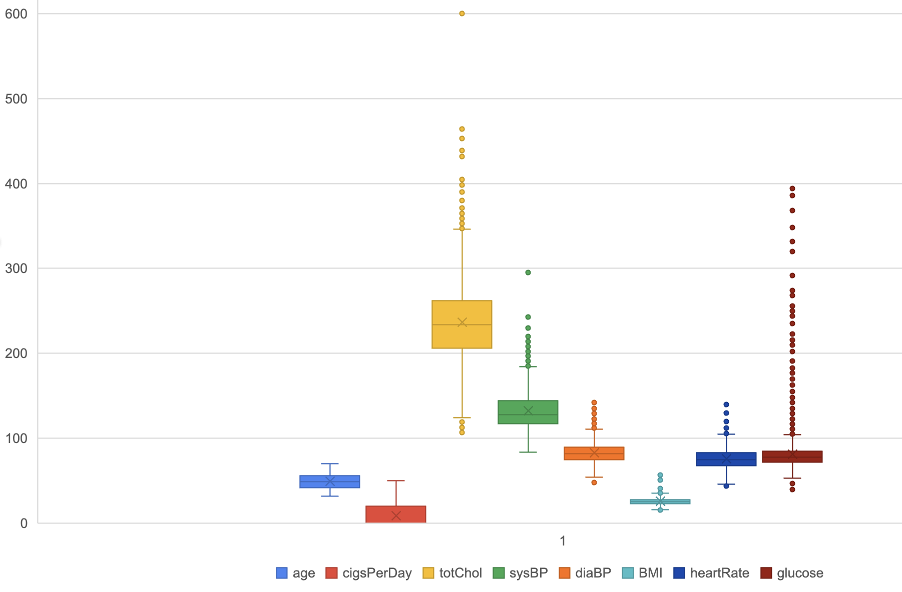
Data cleaning
2. Outliers:
Model 1:
Calculated with quartiles (IQR)
Replaced by lower & upper bounds
Created new variables with binary data (outlier or not)
Model 2 & 3: left outliers
3. Randomization
Shuffled the order to avoid similar data grouped together
Model 3: also generated data beforehand

Slide 5
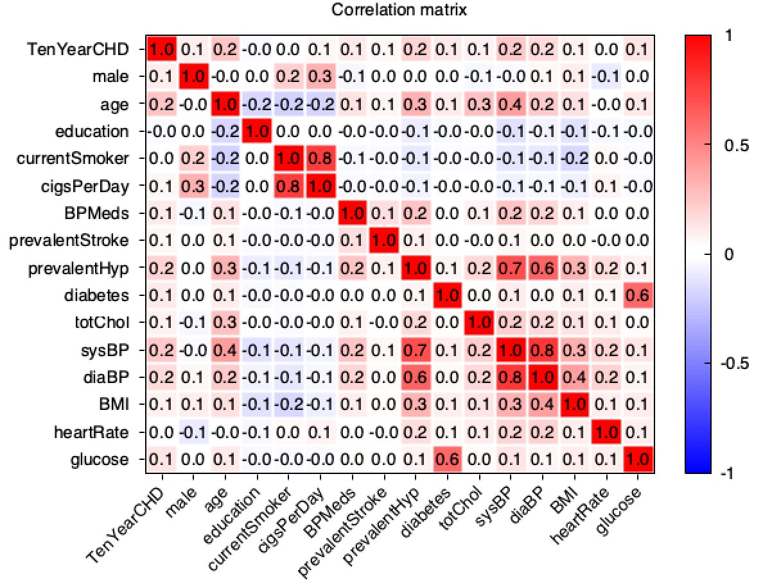
Analysis - GRETL
Initial state:
Dividing data set:
Separated 0-1
Training data set (80%)
Testing data set (20%)
Model 1 & 2: kept the ratio (15%)
Model 3: 50-50% (1000-1000 data record)
Correlation matrix
Eliminated attributes to avoid multicollinearity:
currentSmoker
diaBP
prevalentHyp

Slide 6
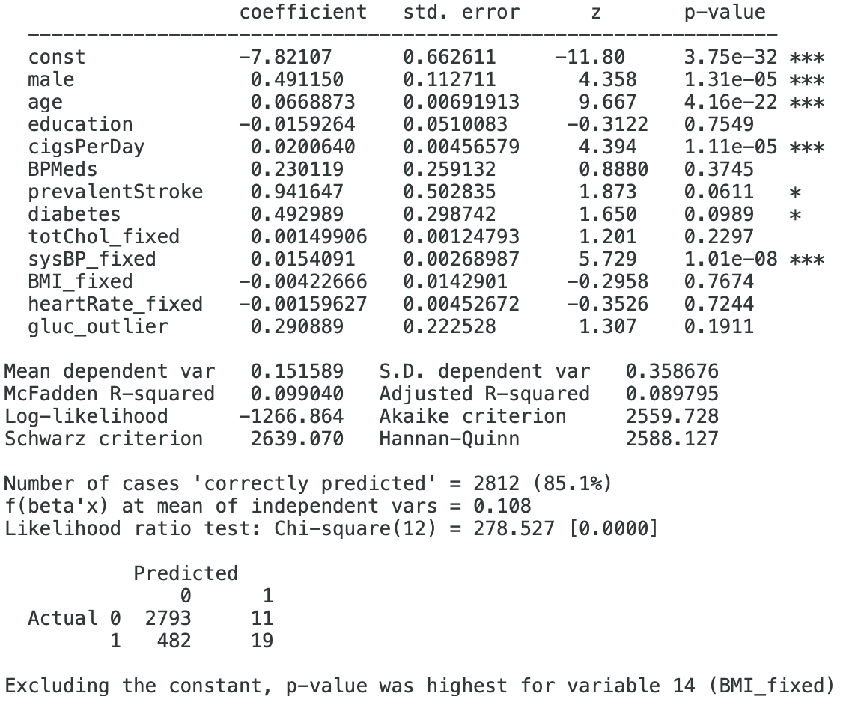
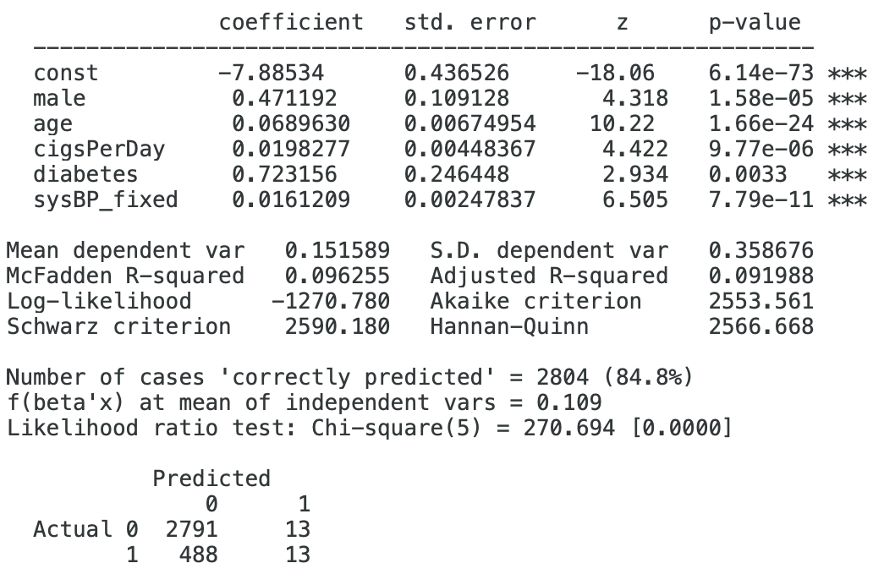
Model 1 – outliers replaced
Initial Model
Final Model (backward selection)

Slide 7
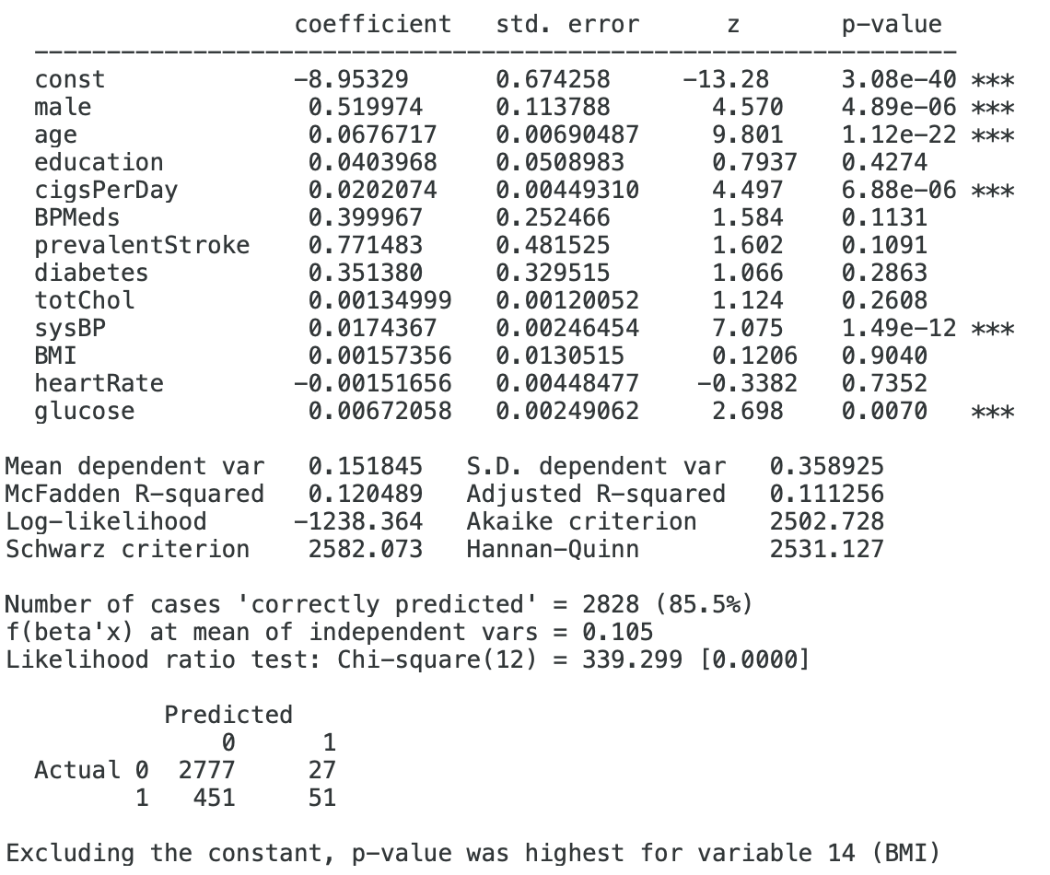
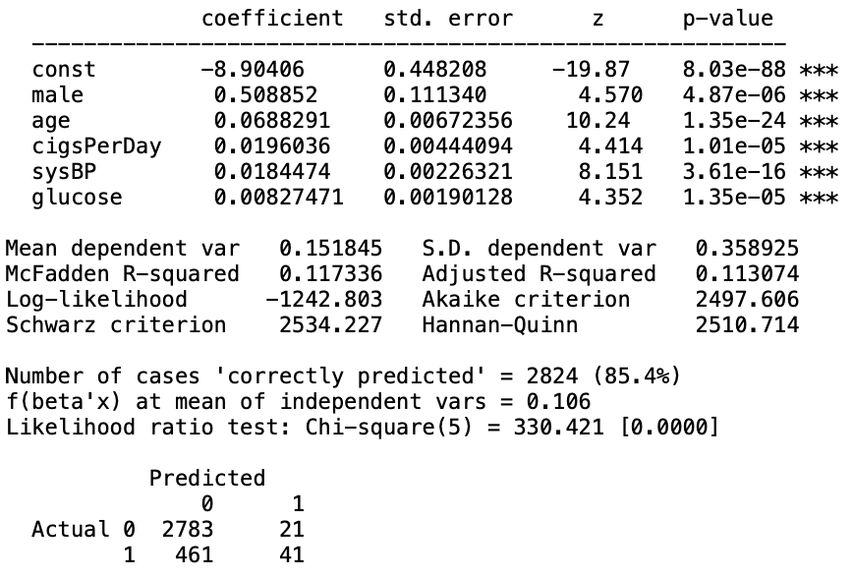
Model 2 – With outliers
Initial Model
Final Model (backward selection)

Slide 8
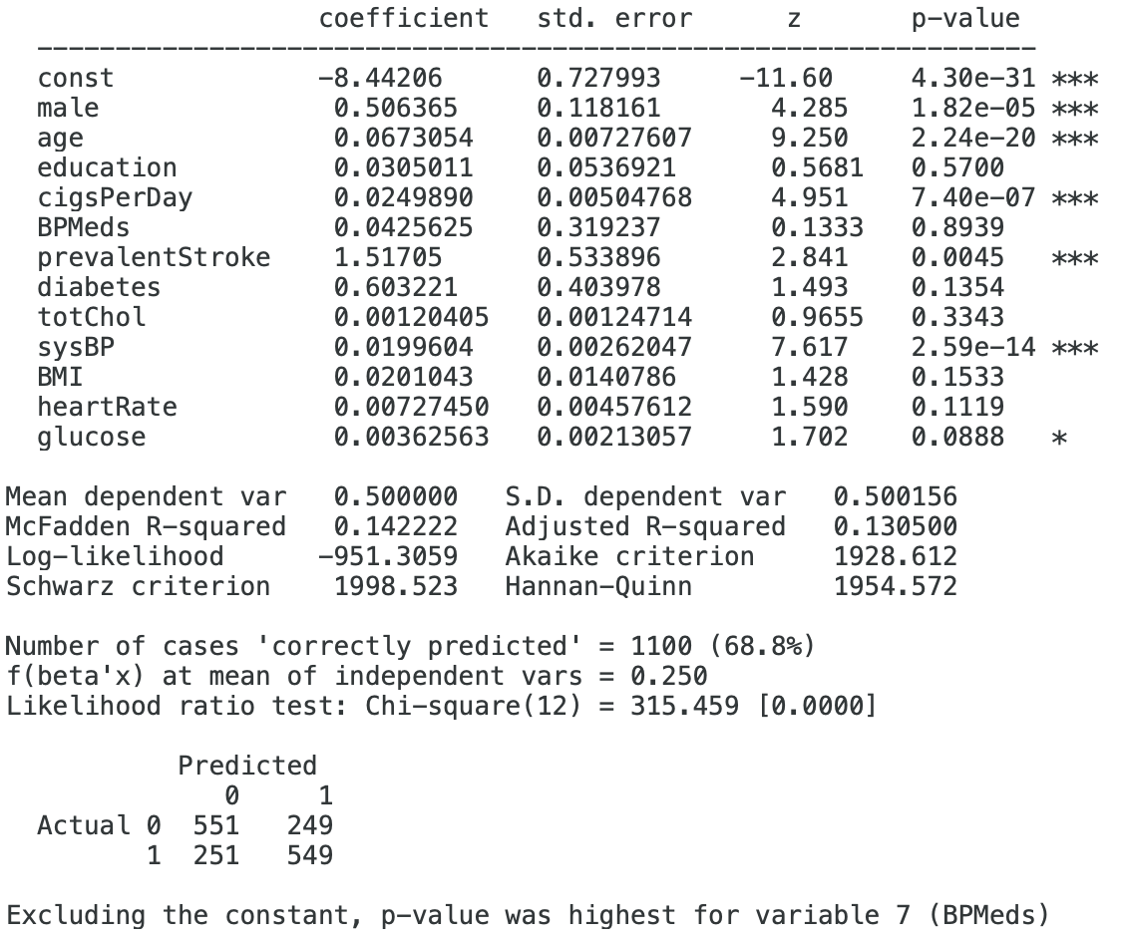
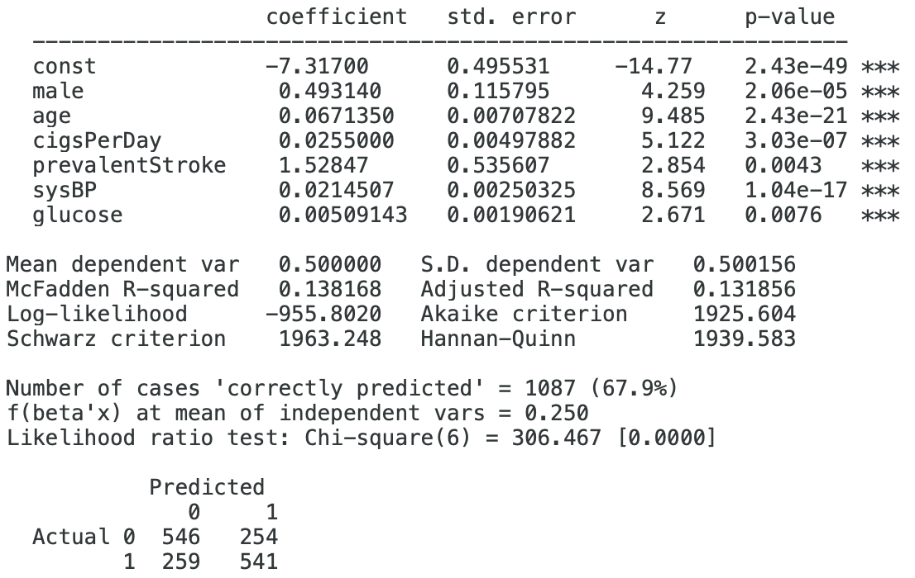
Model 3 – Generated data
Initial Model
Final Model (backward selection)

Slide 9
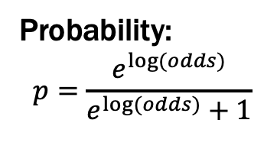
Result
Log(odds) equation: y= coefficients * variables
Model 1:
0.471 * male
0.069 * age
0.02 * cigs
0.723 * diabetes
0.016 * sysBP
-7.885
Model 2:
0.509 * male
0.069 * age
0.02 * cigs
0.018 * sysBP
0.008 * glucose
-8.904
Model 3:
0.493 * male
0.067 * age
0.025 * cigs
1.528 * prevStroke
0.021 * sysBP
0.005 * glucose
-7.317
Probability: $$p=\frac{e^{log⁡(odds)}}{e^{log⁡(odds)}+1}$$

Slide 10
Performance Measures – Model1
Accuracy
Precision
Sensitivity (recall)
False Positive rate
FPR
Maximize recall
AUC=0.6867
Ideal cut-off: Model 1&2: 0.1
Model 3: 0.3
AUC=0.73

Slide 11
Performance measures
Model 1
Model 2
Model 3
Cutoff | Accuracy | Precision | Recall | FP rate
0 | 15.34% | 15.34% | 100.00% | 100.00%
0.1 | 51.33% | 22.29% | 87.40% | 55.21%
0.15 | 65.82% | 27.19% | 73.23% | 35.52%
0.2 | 74.64% | 31.39% | 55.12% | 21.83%
0.3 | 82.49% | 40.63% | 30.71% | 8.13%
0.4 | 85.39% | 57.89% | 17.32% | 2.28%
0.5 | 86.47% | 94.12% | 12.60% | 0.14%
0.6 | 85.27% | 100.00% | 3.94% | 0.00%
0.7 | 84.78% | 100.00% | 0.79% | 0.00%
Cutoff | Accuracy | Precision | Recall | FP rate
0 | 15.24% | 15.24% | 100.00% | 100.00%
0.1 | 49.94% | 20.37% | 78.57% | 55.21%
0.15 | 64.57% | 24.77% | 65.08% | 35.52%
0.2 | 73.64% | 28.90% | 50.00% | 22.11%
0.3 | 80.89% | 33.33% | 25.40% | 9.13%
0.4 | 84.52% | 47.22% | 13.49% | 2.71%
0.5 | 85.01% | 56.25% | 7.14% | 1.00%
0.6 | 85.01% | 60.00% | 4.76% | 0.57%
0.7 | 85.13% | 80.00% | 3.17% | 0.14%
Cutoff | Accuracy | Precision | Recall | FP rate
0 | 50.00% | 50.00% | 100.00% | 100.00%
0.1 | 50.25% | 50.13% | 99.50% | 99.00%
0.15 | 52.00% | 51.04% | 98.50% | 94.50%
0.2 | 54.50% | 52.45% | 96.50% | 87.50%
0.3 | 60.75% | 56.78% | 90.00% | 68.50%
0.4 | 64.25% | 60.92% | 79.50% | 51.00%
0.5 | 68.50% | 69.27% | 66.50% | 29.50%
0.6 | 67.75% | 76.69% | 51.00% | 15.50%
0.7 | 62.50% | 77.17% | 35.50% | 10.50%
0.8 | 55.50% | 80.56% | 14.50% | 3.50%
0.9 | 51.25% | 77.78% | 3.50% | 1.00%

